Slide 1
WWW.ECOVOID.COM
FIRST YEAR PROJECT
Presented By – Sanket and Akash

Slide 2
INTRODUCTION
Ecovoid shopping is the process whereby consumers directly buy goods or top quality product from a Horizon web site, over the Internet.
Ecovoid shopping is the process of buying goods and services from merchants who sell on the Internet.
The Process Of Shopping Done Over The Internet.

Slide 3
PROBLEM STATEMENT
The twenty-first century has already brought a lot of change.
There are a lot of websites on internet whereby it fraud services and offer a variety of product and services for consumer can find and buy through online such as shoe, apparel, sun glasses and more Moreover, the online also provides some of the services which is paying bill online, booking a transport ticket and more. They provide pure product quality and also fraud payment process.
To tackle this major problem we comes with some solution to the people who should know about the new deals and existing offers.
we build an web site who provide best deals, good product quality and secure payment method.

Slide 4
OBJECTIVES
The main objective of the Project on Online Shopping System is to manage the details of Shopping, Product, Internet, Payment, Customer. It manages all the information about Shopping, Delivery, Customer, Shopping. The project is totally built at administrative end and thus only the administrator is guaranteed the access. The purpose of the project is to build an application program to reduce the manual work for managing the Shopping, Product, Delivery, Internet. It tracks all the details about the Internet, Payment, Customer.
To provide the search favorite products and they can add to card and buy any time an any where.
To provide the information related new online shopping deals.

Slide 5
NEED’S
Many people around the world prefer to shop online and buy products from several brands and companies that they cannot find or are not available for purchase in their home countries.
Nowadays, and with the help of the new technology and the support of the internet, people from all around the world started to purchase items online by simply sitting in their homes.
Purchasing items and products through the Web is a very easy task to do. It is now playing a very important role in everybody’s life especially elderly people, as well as people with a very busy life schedule.
It provides a very comfortable service for its customers, by being able to save the item in the personal shopping bag, and buy it later on. Shopping through the Web simply works for people with a valid credit card, a debit card or an internet bank account.

Slide 6
FUTURE SCOPE
Future change in the GUI can be easily adopted by having simple change in coding. It is very user friendly, cost effective, feature rich and it provides very high level of security. It protects the unauthorized users.
Moreover, the system coding is so well designed that new operations can be easily incorporated without much modification.
Different Services to be added in the future are as follows: - 1. Enhancing the performance. 2. Application for IOS based devices. 3. Live chat Bot

Slide 7
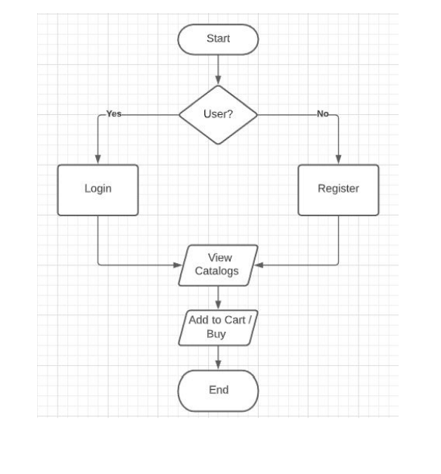
PROJECT FLOW

Slide 8
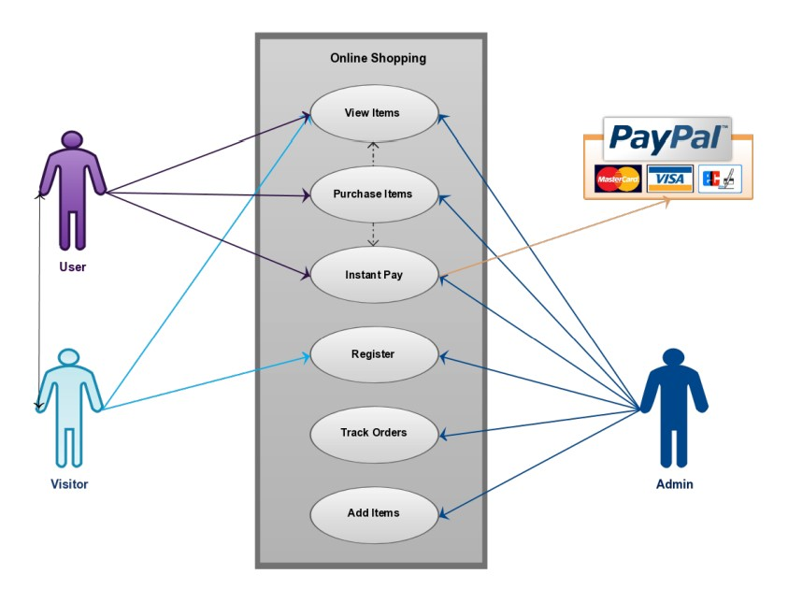
Use Case Diagram

Slide 9
CONCLUSION
The web application will have the benefits of easy access because it is being developed as a simple web application.
Several user friendly coding have also adopted. This package shall prove to be a powerful package in satisfying all the requirements of the user.
All deals and products are available online here so no need to struggle for the favorite products.
The application has been designed keeping in view the present and future requirements in mind and made very flexible.

Slide 10
THANK YOU

